Slide 1
Customising and integrating Data Management Plan to the university process
Experience and thoughts
Zanele Mathe
CPUT Library

Slide 2
CONTENT
CPUT RDM Policy Approval
From policy to implementation
Operational efficiency
Customising DCC DMPOnline tool
Testing the tool
Possible areas of integration
Training and skills development

Slide 3
CPUT RDM policy approval ( July 2014)
Statements in the policy:
5,1.2 All research proposals (for funded and non-funded research) should include a data management plan (DMP), including sufficient metadata to aid discovery
5.2. 1 In joint research projects, the University must ensure that the MOU clarifies how research data will be managed.
6.2 Lead Researcher is responsible for:
Effecting research data management through the use of data management plan (DMP) from the early stages to the final course of research projects.
Ensuring that actions outlined in the DMP and this policy are carried out and adhered to.

Slide 4
From policy to implementation
Explore Data Management Plan tools that are in the market already e.g. DCC DMP Online tool, DMPTool(Univ. of California Centre)
Break down institutional silos,
Supplement internal library skills as much as possible.
Notes:
When operating data is fragmented across the organization, personnel have to either chase down information from multiple sources or make decisions without a full understanding of the impact on interdependent systems, potentially creating new problems to be addressed.

Slide 5
Operational efficiency
People
Technology
Processes
Notes:
Operational efficiency requires an approach that optimizes the relationships between people, process and technology.
Increased collaboration across the business
Def: Capability of an enterprise to deliver products or services to its customers in the most cost effective manner possible while still ensuring the high quality of its products, service and support.
It is often achieved by streamlining a company’s core processes in order to more effectively respond to continually changing market forces in a cost effective manner.

Slide 6
TECHNOLOGY Customizing DCC DMPOnline tool
Discussion on Skype session (Sarah & Joy – May 2014)
CPUT added as an organization on DCC DMPOnline tool
Edit rights given for the admin area to create and add our own CPUT template and guidance
Following links were shared:
webinar on Customizing DMPOnline –
slides, http://www.slideshare.net/sjDCC/custominsing-dmponline-webinar
Original blog post on how to customise DMPonline: http://www.dcc.ac.uk/news/customising-dmponline
Customising DMPOnline video: http://www.youtube.com/watch?v=jlBjtjWFeoA&list=UULTOHF6qQrYhEvQzbu03tTg
Webinar on using the admin interface: http://www.youtube.com/watch?v=XQkHg1YYdew&list=UULTOHF6qQrYhEvQzbu03tTg
Research360 DMP template for PhD students – http://blogs.bath.ac.uk/research360/2012/03/19/postgraduate-dmp-template-first-draft/
DataTrain DMP template for PhDs – http://www.lib.cam.ac.uk/preservation/datatrain/Post-Graduate_DMP_Form.pdf

Slide 7
Customization continues….
Created the CPUT template using the DCC Checklist for a Data Management Plan, v4.0 and York University Libraries DMP planning checklist
Listened to both webinars and followed instructions and guidance as directed
CPUT DMPOnline template and guidance was developed and published
Notes:
Avoid long template and be selective in questions

Slide 8
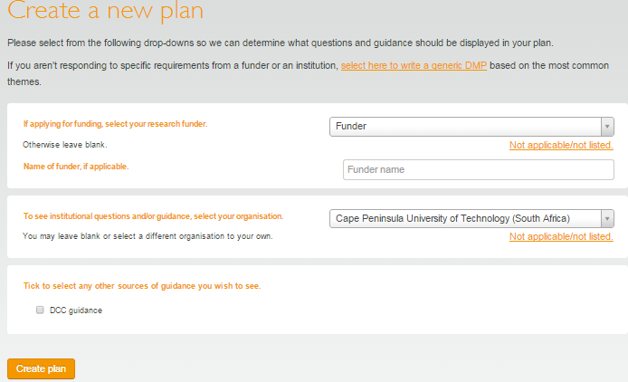
CPUT DMP template

Slide 9
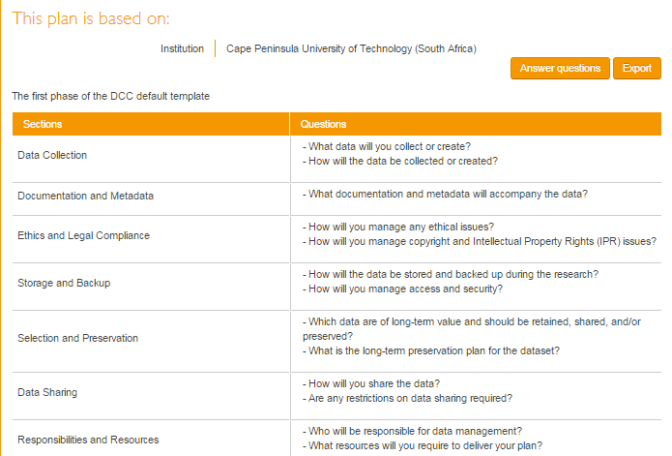

Slide 10
Testing…
Tested the DMPOnline template with 5 researchers and 4 librarians
Reworked some questions and guidance
Presented the tool to Senate Research Committee (20 October 2014) and asked committee members to test
One challenge: site displayed as unsafe…

Slide 11
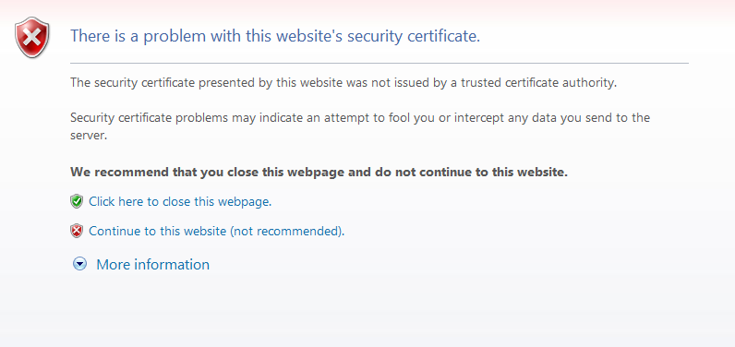
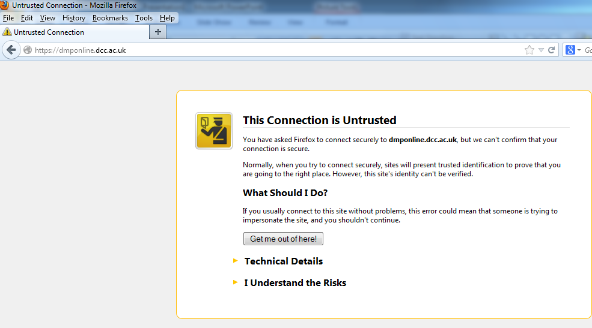
One Hick up!…

Slide 12
PROCESSES Possible areas for integration
Grant application process and sub-processes involved (monitoring process e.g. progress report & completion)
Teaming agreements
Collaboration agreements
Intellectual property agreements
Resignation and retirement process. (Research data Declaration signed by immediate Senior)
Notes:
IP Agreements cover inventions or other discoveries that may result from a collaboration.
all parties should have a clear understanding of who will determine how the data will be distributed and shared (if applicable) even before it is collected.
The basic issue covered is ownership of the intellectual property (i.e. who owns what, and under what conditions).
if an invention is patented, technical data supporting the invention should be maintained for the life of the patent.

Slide 13
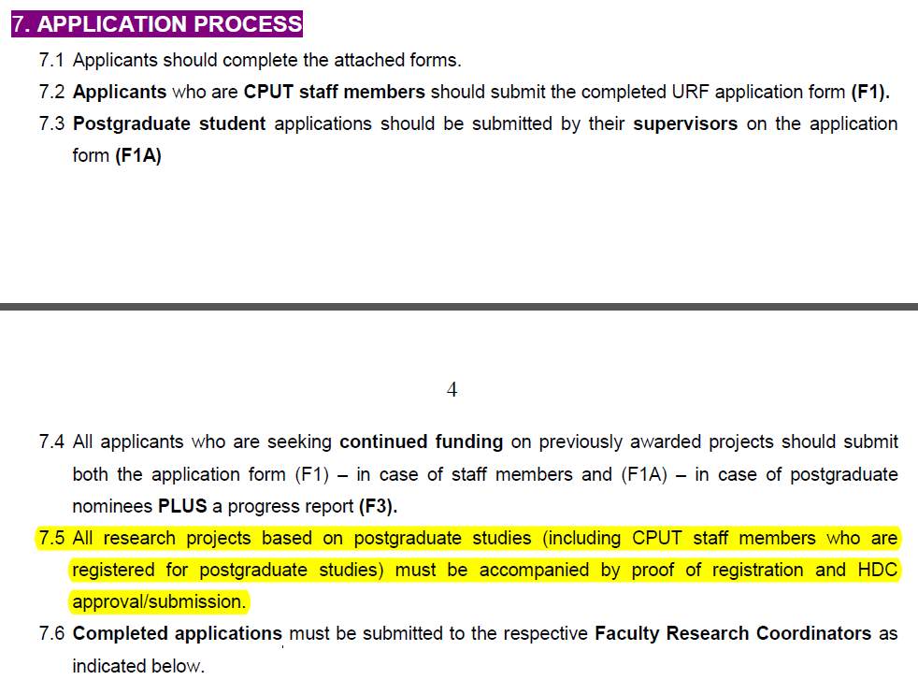
Grant application process
CPUT Grant application Call - URF
UNIVERSITY RESEARCH FUND (URF): Call for applications

Slide 14
Grant application process flow

Slide 15
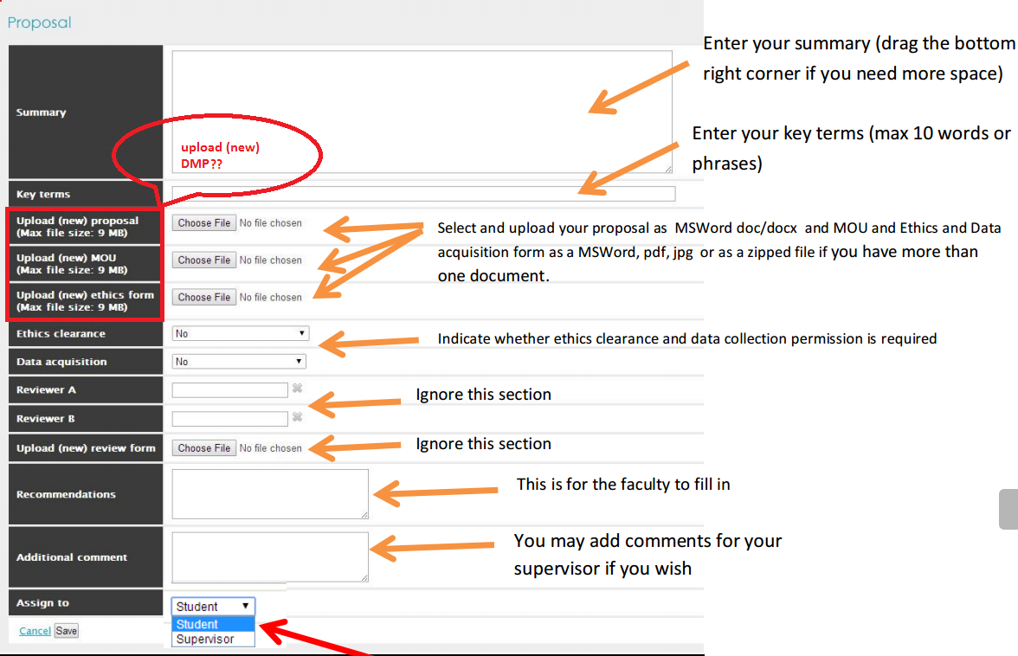
Registration of Proposal for Dissertation / Thesis platform (HDC Digital)

Slide 16
PEOPLE
Re-skilling librarians
supplementing library skills
increasing collaboration

Slide 17
Thank you!
QUESTIONS???

Slide 18
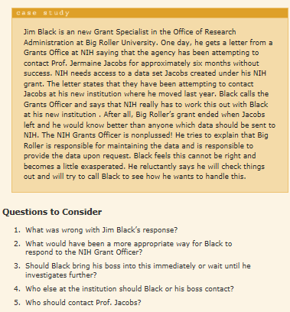
Grant Application Case Study

